Slide 1

Storage Management
File System
Mass Storage Structure
I/O Systems

Slide 2
Storage Management
Secondary storage of the computer provides backup to the main memory for all programs
All data and programs are stored permanently
Disks are used as the primary on-line storage medium
File-system provides mechanism for on-line storage
A file is a collection of related information defined by its creator
OS maps the files onto physical devices
Files are organized into directories for ease of use
File-system is the most visible aspect of an OS
Notes:
I/O devices: Varying characteristics. OS provides the simplest interface to a wide range of devices to applications and programmers

Slide 3
File System
A file is an abstract data type defined and implemented by the OS
It consists of a sequence of logical records
File-system consists of two distinct parts
A collection of files that store related data
A directory structure that organizes and provides information about all the files in the system
Various aspects of files and the major directory structures
Semantics of sharing files among multiple processes, users and computers
Ways to handle file protection
Notes:
Concept, Access methods, directory and disk structure, Mounting, sharing and protecting, locking of files, etc.

Slide 4
Mass Storage Structure
Disk Structure
Disk Scheduling
Notes:
Disk formatting; Swap space; Management of boot blocks, Structure and operation of RAID systems

Slide 5
Secondary (Mass) Storage Structure
Disk drives are the major secondary storage I/O devices on most computers
These are structured as a large one-dimensional array of logical disk blocks
Request for disk I/O is generated by the file system and virtual memory system
Disk scheduling algorithms are used to improve the disk bandwidth, average response time and the variance in response time
FCFS, SSTF, SCAN, C-SCAN and C-LOOK are the disk scheduling algorithms
Swap space provides an efficient interface to paging systems
Disks can suffer from external fragmentation
Notes:
Platter (1.8” to 3.5”), read/write head, disk arm, tracks, sectors, cylinder, RPM is the rotational speed(60 to 25 times/sec), disk speed: transfer rate+ positioning time(seek time+rotational latency)

Slide 6
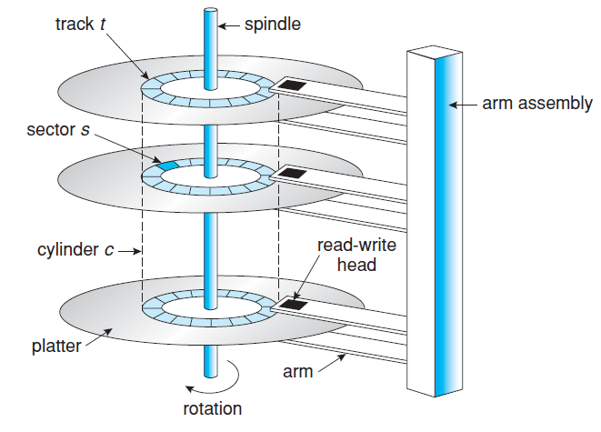
Moving-head disk mechanism
Notes:
Platter (1.8” to 3.5”), read/write head, disk arm, tracks, sectors, cylinder, RPM is the rotational speed(60 to 250 times/sec), disk speed: transfer rate+ positioning time(seek time+rotational latency)

Slide 7
Disk Scheduling
Access time components
Seek time and rotational latency
Seek time is the time for the disk arm to move the heads to the cylinder containing the desired sector
Rotational latency is the additional time for the disk to rotate the desired sector to the disk head
Bandwidth is the total number of bytes transferred divided by the total time
Both access time and bandwidth can be improved by managing the order in which disk I/O requests are serviced
Notes:
Seek time and rotational latency is of a few msec.

Slide 8
Disk Scheduling
Disk queue may have several pending requests at any point in time
Any one of the several disk scheduling algorithms can be used
Access time and bandwidth can be improved by managing the order of disk I/O requests
FCFS Scheduling
Fair algorithm but does not provide fastest service
I/O requests to blocks on cylinders – initial head position is 53
98, 183, 37, 122, 14, 124, 65, 67
Total head movement is 640 cylinders
Total head movement can be decreased substantially
Notes:
Wild movement from 37 to 122, then to 14 and back to 124 is the real problem with this scheme

Slide 9
Disk Scheduling
SSTF Scheduling
Service all requests close to the current head position before moving the head to service other requests
Shortest Seek Time First algorithm
Total head movement is 236 cylinders
Not an optimal algorithm
Starvation may take place
SCAN Scheduling
The disk arm starts at one end and moves towards the other end, servicing requests as it reaches each cylinder
Direction of head movement reverses after reaching the other end
Notes:
SSTF: starvation may take place

Slide 10
Disk Scheduling
This is also called the elevator algorithm
Head position is 53 and is moving towards 0
A total of 173 head movement
C-SCAN (Circular SCAN) Scheduling
Provides a more uniform wait time
The head moves from 0 to Max, while servicing the requests
It immediately returns to the beginning
183 total head movement
LOOK Scheduling
Disk arm does not move across the full width of the disk
Arm goes to as far as the final request in each direction
Notes:
SSTF: starvation may take place

Slide 11
Disk Scheduling
A total of 153 head movements
Another variant is the C-LOOK scheduling algorithm
Choice of a disk scheduling algorithm is dependent on a number of factors
File allocation method
Location of directories and index blocks
Behavior of applications for generating disk requests
Notes:
SSTF: starvation may take place

